Slide 1
4. MLOps in Azure
Avanade ASG Data Science Bootcamp

Slide 2
Agenda
14:00 – 15:15
15:15 – 15:30
15:30 – 17:00
Theory part
Laura and Mojtaba
Introduction
ML life cycle
DevOps
MLOps
MLOps in Azure
Break
Demo
Sebastian
Notes:
Blue: need Azure

Slide 3



1. Introduction
You have already created a ML model on your local computer (Jupyter notebooks)
This is good enough for research and development
However in industry, we would like to serve this trained model for end-users to consume
More concretely, consider the Azure Cognitive Services, e.g., the image recognition service
You have already developed an image recognition model using deep learning (session 7)
You want to serve your model in Jupyter notebook in the form of image recognition service!
What extra steps do you need to take?
Which tools should we use?
What challenges will you encounter?
What kinds of personas/roles must be involved in addition to data scientists?
How can we achieve full automation?
Input data
Data preprocessing
Model training
Consume Predictions

Slide 4
1. Introduction
The environment in which you trained your model is called the development environment.
The environment in which the model is served for end-user is called the production environment.
The main task here is to productionize our model, i.e., to deploy our model to production.
Productionizing other software development projects is done within the DevOps framework.
However productionizing ML models, faces new challenges:
Experimental nature of ML models: we run several algorithms, with different hyperparameters and different feature engineering methods → keep track of different experiments and runs
Reproducibility: it could often happen that when we re-run a ML model, we get different results! This could happen because of changes in code, data, env → need a robust implementation
Retraining: ML model training on our local Machine is a one-time activity. However, in production, we would like to add the new data by the end-user to retrain our model, several times to improve its performance continuously.
Automation: we would like all these goals to be achieved in an automated fashion → multi-step pipelines to automatically retrain and deploy a model
MLOps = ML + DevOps
MLOps is a set of practices to manage the full ML Lifecycle

Slide 5
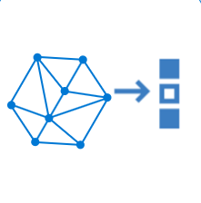
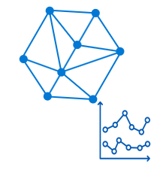
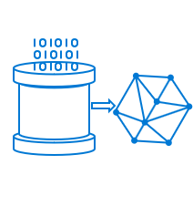
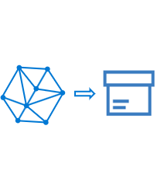
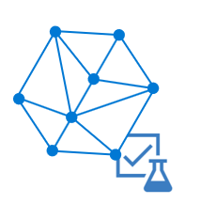
2. ML Lifecycle
The ML Lifecycle consists of different stages that a ML project must go through in order to fulfill the project‘s goal
Experiment Tracking
Deploying
Monitoring
Train/Test
Package
Validate
Retraining

Slide 6
Experiment Tracking
ML model building is an experimental activity which involves
Train and Test:
different preprocessing, feature engineering → data versioning
different algorithms,
different hyperparameters → model tuning
Packaging:
To prepare the necessary components of the prod. env., we need to bundle all the OS images, libraries and ML codes together (e.g., in the form of a Docker image)
Validate:
Evaluates how model performance compares to their business goals. For example, a company might want to optimize for accuracy over speed in some cases. ​
Repeat Steps 1-3: It can take hundreds of training runs to find a satisfactory model.
Experiment is a collection of different runs, metrics and artifacts
Experiment Tracking: systematically keeping track of different Experiment’s runs
Ideally the model improves with each round of adjustment. Ultimately, it's the development team's role to determine which version of the model best fits the business use case.​
Train/Test
Package
Validate
Experiment Tracking
Deploying
Monitoring
Retraining

Slide 7
Model Deployment
Machine learning model deployment is the process of placing a finished ML model into a live environment where it can be used for its intended purpose.
Automated deployment is done via pipelines
Pipeline: a set of consecutive tasks which will be performed automatically. It allow developers to reliably and efficiently compile, build, and deploy their code to an environment.
Models are often integrated with apps through an API so they can be accessed by end users
Testing Env
Staging Env
Production Env
Development Environment
Deployment
Experiment Tracking
Deploying
Monitoring
Retraining

Slide 8
Model Monitoring
Even if a model works well at first, it needs to be continually monitored and retrained to stay relevant and accurate.
The deployed model’s performance may decrease overtime, because of:
Changes in data distributions
Outdated environment
Outdated model
ML monitoring is the practice of tracking the performance of ML models in production to identify potential issues in ML pipelines
When monitoring indicates a performance degradation, it will trigger the model retraining…
Experiment Tracking
Deploying
Monitoring
Retraining

Slide 9
Retraining (Continuous Training)
For different reasons, we may want to retrain our model:
Concept Drift: statistical properties of the target (y) change
Data Drift: statistical properties of the features (X_i) change
Example: Spam detection
Emails which used to be classified as spam are not spam anymore → concept drift
Email content and presentation change constantly → data drift
ML model retraining, or continuous training (CT), is the MLOps capability to automatically and continuously retrain a machine learning model on a schedule or a trigger driven by an event.
Experiment Tracking
Deploying
Monitoring
Train/Test
Package
Validate
Retraining

Slide 10
DevOps
Avanade ASG Data Science Bootcamp

Slide 11





Pre DevOps: Wall of Confusion
The developers throw their code “over the wall” to the operators and ignore what must be done to get the software in a deployable state.
Developer
Wall of confusion
Operator

Slide 12
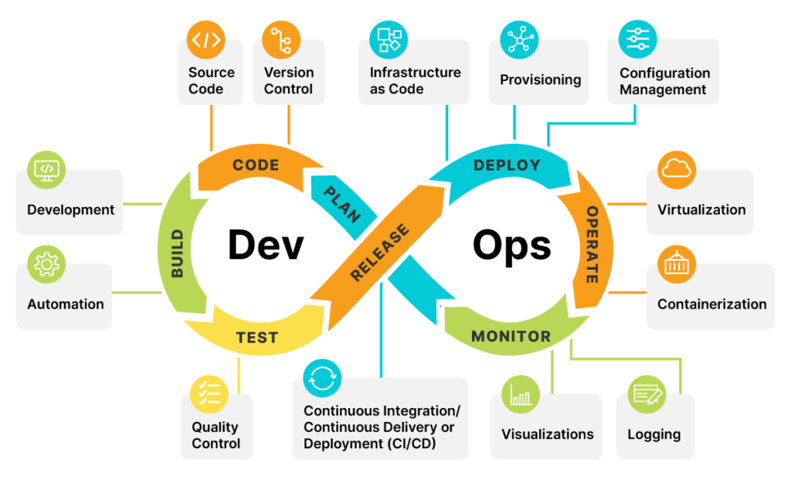
DevOps
DevOps is a set of practices that automates the process between software development (Dev) and IT operations (Ops).
https://orangematter.solarwinds.com/wp-content/uploads/2022/03/DevOps-lifecycle-capabilities-1024x621.png

Slide 13

How do we get there? – The Three Ways
1.
Principle of Flow
Automation with CI/CD Pipelines
Principle of Feedback
Monitoring also for the developer
Principle of Continuous Learning
Feedback loops enable experimentation
2.
3.

Slide 14
Automation: CI/CD
CI (Continuous Integration)
Automation process for developers
Code changes are regularly built, tested and merged to a repository
CD (Continuous Delivery / Deployment)
Automated delivery / deployment of validated code

Slide 15





Continuous Integration
Time to resolve merge conflict: 2h
=>single big merge conflict

Slide 16


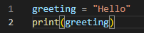
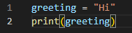
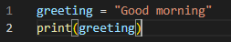
Merge Conflict

Slide 17

Continuous Integration
Time to resolve merge conflict: 2h
Time to resolve merge conflict: 20 mins
=>single big merge conflict
=>multiple small merge conflicts
Notes:
Slide changed

Slide 18
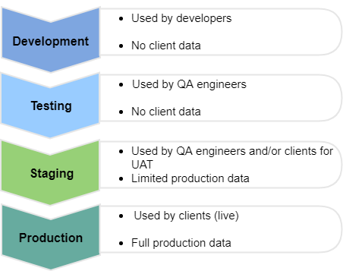
Environments in software development
https://oroinc.com/b2b-ecommerce/wp-content/uploads/sites/3/2019/05/Software-environments.png
Notes:
UAT = User Acceptance testing

Slide 19
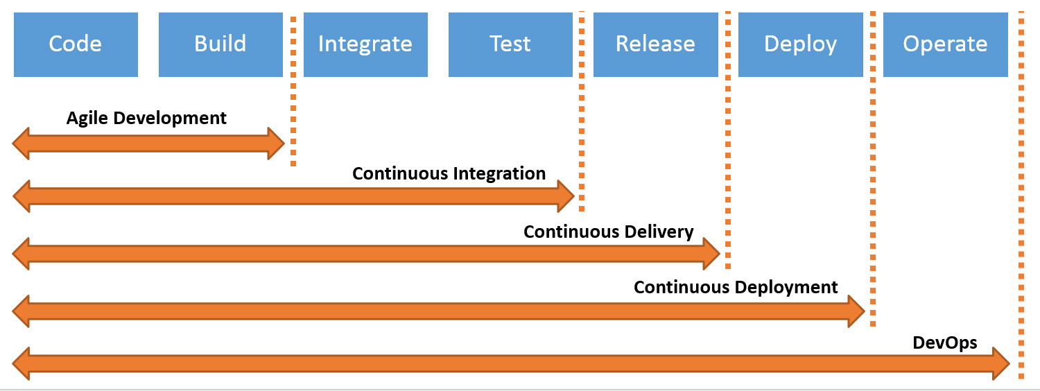
Continuous Delivery / Deployment
Continuous Delivery automatically deploys code changes to a testing and/or production environment
With Continuous Deployment every change is released automatically to the customers
https://s7280.pcdn.co/wp-content/uploads/2017/06/ci-vs-cd-devops-difference.jpg

Slide 20
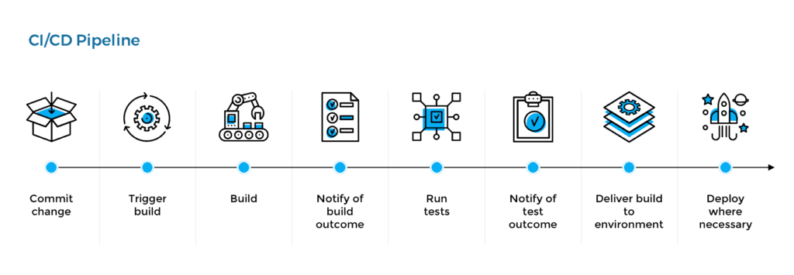
CI/CD pipeline
Release Pipeline
With a CI/CD pipeline developers can make changes to code that are then automatically tested and delivered/deployed.
Build pipeline
https://1ohvy81v7br01wtgnj4bf0ek-wpengine.netdna-ssl.com/wp-content/uploads/2019/03/cicd-pipeline-1024x355.png

Slide 21




DevOps Research and Assessments Group (DORA)
Central question: “what are highest performing software companies doing to be so successful?”
Speed
Stability
106x
faster code deployments
208x
More code deployments
2604x
faster recovery from incidents
7x
Lower change failure rate

Slide 22
MLOps
Avanade ASG Data Science Bootcamp

Slide 23






Current ML Pain Points
Outdated ML models
Governance
Automation
Reproducibility
Effort and Time
Scalability

Slide 24
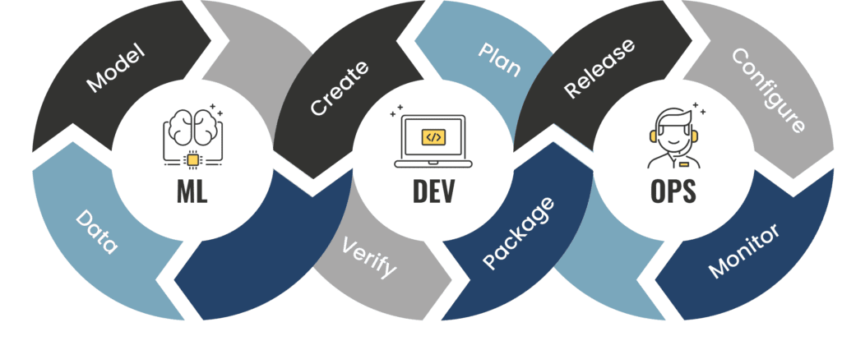
MLOps
MLOps combines Machine Learning with DevOps. It aims to deploy and maintain machine learning models reliably and efficiently.
https://i0.wp.com/www.phdata.io/wp-content/uploads/2021/07/code-validate-deploy-loop-1024x426.png

Slide 25
MLOps vs DevOps (1)
Development
ML is experimental
Testing
additional tests for data and model validation are needed
Deployment
Automatical retraining and deployment may be needed
Production
performance of the model can decrease
Skills
Data scientists are usually not experienced software developers

Slide 26
MLOps vs DevOps (2)
Continuous Integration (CI) extends the testing and validating code and components by adding testing and validating data and models.
Continuous Delivery (CD) concerns the delivery of an ML training pipeline that automatically deploys another ML model prediction service.
Continuous Training (CT) is unique to ML systems property, which automatically retrains ML models for re-deployment.
Continuous Monitoring (CM) concerns monitoring production data and model performance metrics, which are bound to business metrics.

Slide 27
MLOps – The Three Ways
Manual process
Data Scientist doesn’t get feedback
No monitoring
No retraining
ML pipeline automation
Data Scientist gets feedback
Monitoring
Retraining
No CI
No versioning
CI/CD pipeline automation
Data Scientist gets feedback
Monitoring
Retraining
CI
Versioning
0.
1.
2.
Notes:
Nochmal gucken, was Unterschied zwischen 1 und 2 ist

Slide 28
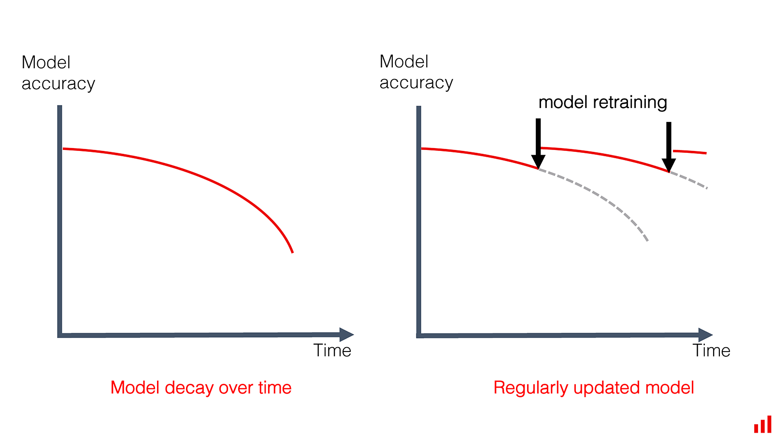
Reasons for retraining
new training data
Data schema/distribution changes
Outdated environment
new training approaches
Models may degrade over time
Concept drifts
Models may be deployed in new applications
Models may be subject to attack and require revision
roll back to a previous version
https://static.tildacdn.com/tild3462-6534-4732-a462-643534313536/model_decay_retraini.png

Slide 29
MLOps – The Three Ways
Manual process
Data Scientist doesn’t get feedback
No monitoring
No retraining
ML pipeline automation
Data Scientist gets feedback
Monitoring
Retraining
No CI
No versioning
CI/CD pipeline automation
Data Scientist gets feedback
Monitoring
Retraining
CI
Versioning
0.
1.
2.
Notes:
Nochmal gucken, was Unterschied zwischen 1 und 2 ist

Slide 30
The Three Ways: Manual process
ML
Ops
Offline data
Manual experiment steps
Data extraction and analysis
Data preparation
Model training
Model evaluation and validation
Trained model
Model serving
Development/test
Model registry
production
Prediction service

Slide 31
The Three Ways: ML pipeline automation
Model analysis
ML
Ops
Data analysis
Data validation
Data preparation
Model training
Model evaluation
Model validation
Source code
Source repository
Pipeline deployment
Orchestrated experiment
Feature Store
Development/test
production
Model registry
Trained model
Data extraction
Data validation
Data preparation
Model training
Model evaluation
Model validation
CD: Model serving
Automated pipeline
Trigger
Performance monitoring
Prediction service

Slide 32
Triggers for retraining
Calendar events
Availability of new training data
Model performance degradation
Concept drift
changes on data, model training code or application code
On demand

Slide 33
The Three Ways: ML pipeline automation
Model analysis
ML
Ops
Data analysis
Data validation
Data preparation
Model training
Model evaluation
Model validation
Source code
Source repository
Pipeline deployment
Orchestrated experiment
Feature Store
Development/test
production
Model registry
Trained model
Data extraction
Data validation
Data preparation
Model training
Model evaluation
Model validation
CD: Model serving
Automated pipeline
Trigger
Performance monitoring
Prediction service

Slide 34
The Three Ways: CI/CD Pipeline automation
Model analysis
Data analysis
Data validation
Data preparation
Model training
Model evaluation
Model validation
Source code
Source repository
CI Pipeline
Packages
Orchestrated experiment
CD: Pipeline deployment
Feature Store
Development/test
production
Model registry
Trained model
Data extraction
Data validation
Data preparation
Model training
Model evaluation
Model validation
CD: Model serving
Automated pipeline
Trigger
Performance monitoring
Prediction service

Slide 35
Key Takeaways
Train / re-train reproducible ML models
Simplify model deployment preparations
Monitor concept drift
Consume, observe and explain model behavior

Slide 36
4. MLOps in Azure

Slide 37
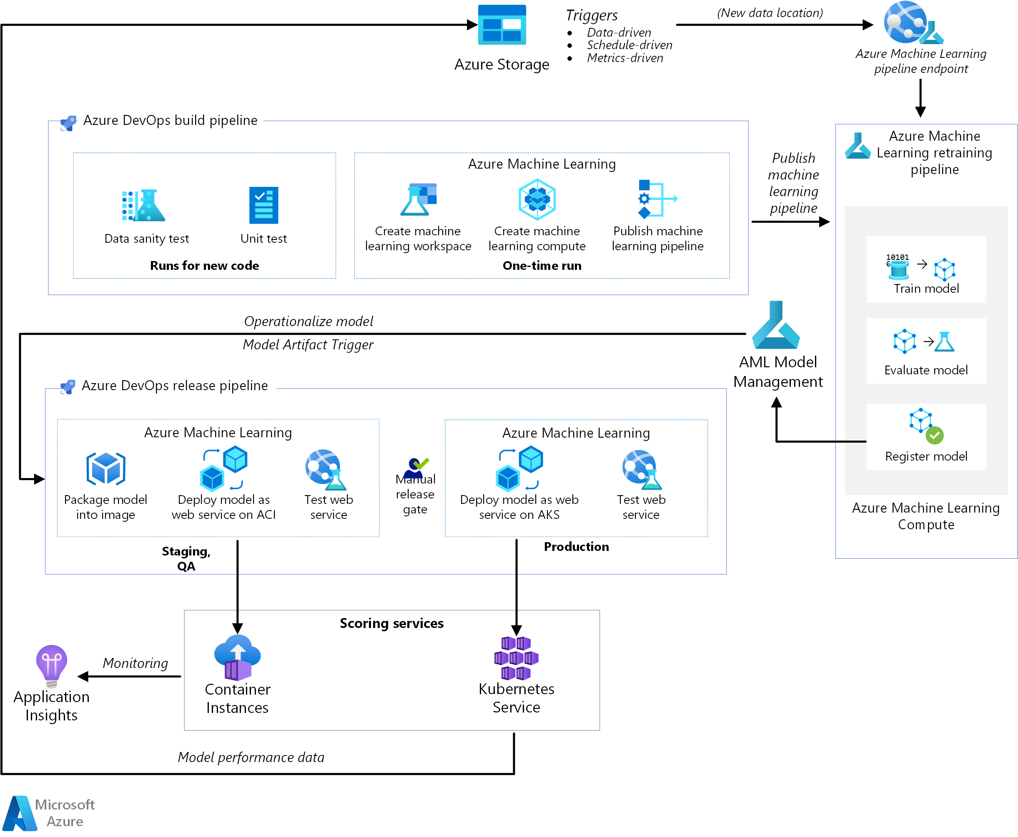







4. MLOps in Azure
A typical MLOps architecture within Azure ecosystem consists of the following components:
Azure Pipelines (Build and Release)
Azure Machine Learning
Azure Blob Storage
Azure Container Registry
Azure Container Instances
Azure Kubernetes Service
Azure Application Insights
https://docs.microsoft.com/en-us/azure/architecture/reference-architectures/ai/mlops-python
Azure Architecture Center
A very rich and valuable resource containing guidance
for architecting solutions on Azure using established
patterns and practices.
https://docs.microsoft.com/en-us/azure/architecture/

Slide 38
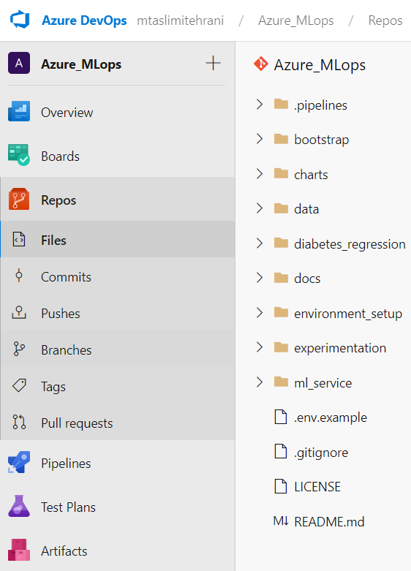
Azure DevOps
Azure DevOps is a Microsoft service that covers the entire application lifecycle, and enables DevOps capabilities, including:
Repository, version control (similar to GitHub)
Automated builds,
CI/CD pipelines
Requirements management,
Project management,
Testing and release management capabilities.
Azure Pipelines (Build and Release)
Azure Pipelines automatically builds and tests code projects to make them available to others.
It works with just about any language or project type.
Azure Pipelines combines continuous integration (CI) and continuous delivery (CD) to test and build your code and ship it to any target.

Slide 39
Azure Machine Learning
(AML)
AML is a cloud service for training, scoring, deploying, and managing machine learning models at scale.
AML consists of 3 main components:
Azure Machine Learning Workspace
An AML workspace provides the space in which to experiment, train, and deploy machine learning models.
Azure Machine Learning Compute
AML Compute is a cluster of virtual machines on-demand with automatic scaling and GPU and CPU node options. The training job is executed on this cluster.
Azure Machine Learning pipelines (Training)
AML pipelines provide reusable ML workflows that can be reused across scenarios.
Training, model evaluation, model registration, and image creation occur in distinct steps within these pipelines for this use case.
The pipeline is published or updated at the end of the build phase and gets triggered on new data arrival (retraining).
For automation in MLOps, we typically use the AML Python SDK (instead of the AML Designer) to create a workspace, compute resources, the ML training pipeline.

Slide 40

Azure Blob Storage
Azure Data Lake Storage
Azure Blob storage is Microsoft's object storage solution for the cloud. Blob storage is optimized for storing massive amounts of unstructured data.
Azure Data Lake Storage is a scalable data storage and analytics service.
Azure Data Lake includes all the capabilities required to make it easy for developers, data scientists, and analysts to store data of any size, shape, and speed, and do all types of processing and analytics across platforms and languages.
For MLOps, both the input data and the model prediction as well as the logs from the scoring service are stored in Blob storage.

Slide 41
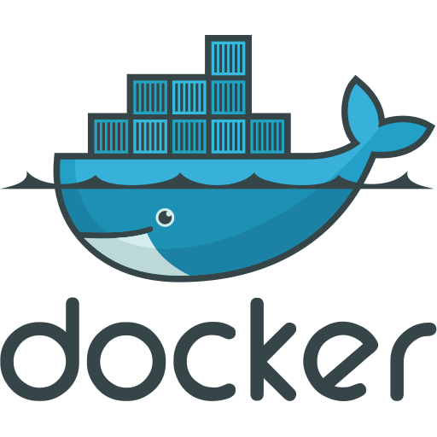

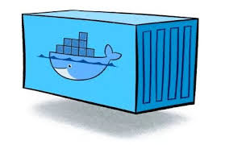
Azure Container Registry (ACR)
ACR is a private registry service for building, storing, and managing container images.
Containers are a way to bundle your OS, environments, libraries and your code and run it wherever needed.
Containers are lightweight and contain everything needed to run the application, so you do not need to rely on what is currently installed on the host.
Docker is an an open platform to create and run containers (containerization) in 5 steps:
Create a docker file (=defining steps needed to create an image )
Build the docker file into an image (=blueptrint of containers)
Push the image to ACI (or other registries like DockerHub)
Pull the image from ACI to your machine
Run containers (= running instances of images).
In MLOps, the ML script is packaged as a Docker image and versioned in ACR.
Docker Image
Dockerfile
Pull
image
Build
Docker Container
Docker Image
Push
ACI
Docker Image
Pull
image
Docker Container

Slide 42
ACI offers the fastest and simplest way to run a container in Azure, without having to manage any virtual machines and without having to adopt a higher-level service.
Azure Container Instances is a great solution for any scenario that can operate in isolated containers, including simple applications, task automation, and build jobs.
In MLOps, as part of the release pipeline, the QA and staging environment is mimicked by deploying the scoring webservice image to Container Instances, which provides an easy, serverless way to run a container.
Azure Container Instances
(ACI)
Notes:
When you create an inmage on ACR, you would like to run it some where in Azure. For that, you need to have compute clusters and infrastructure.
ACI provides the infra for the case of single, isolated containers

Slide 43
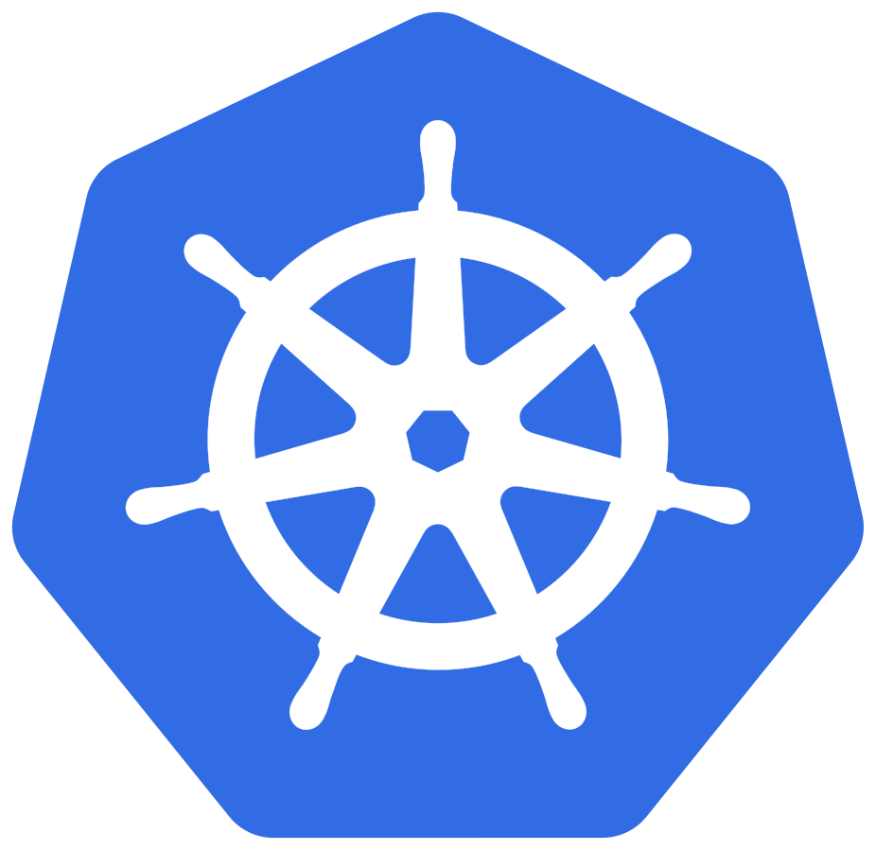
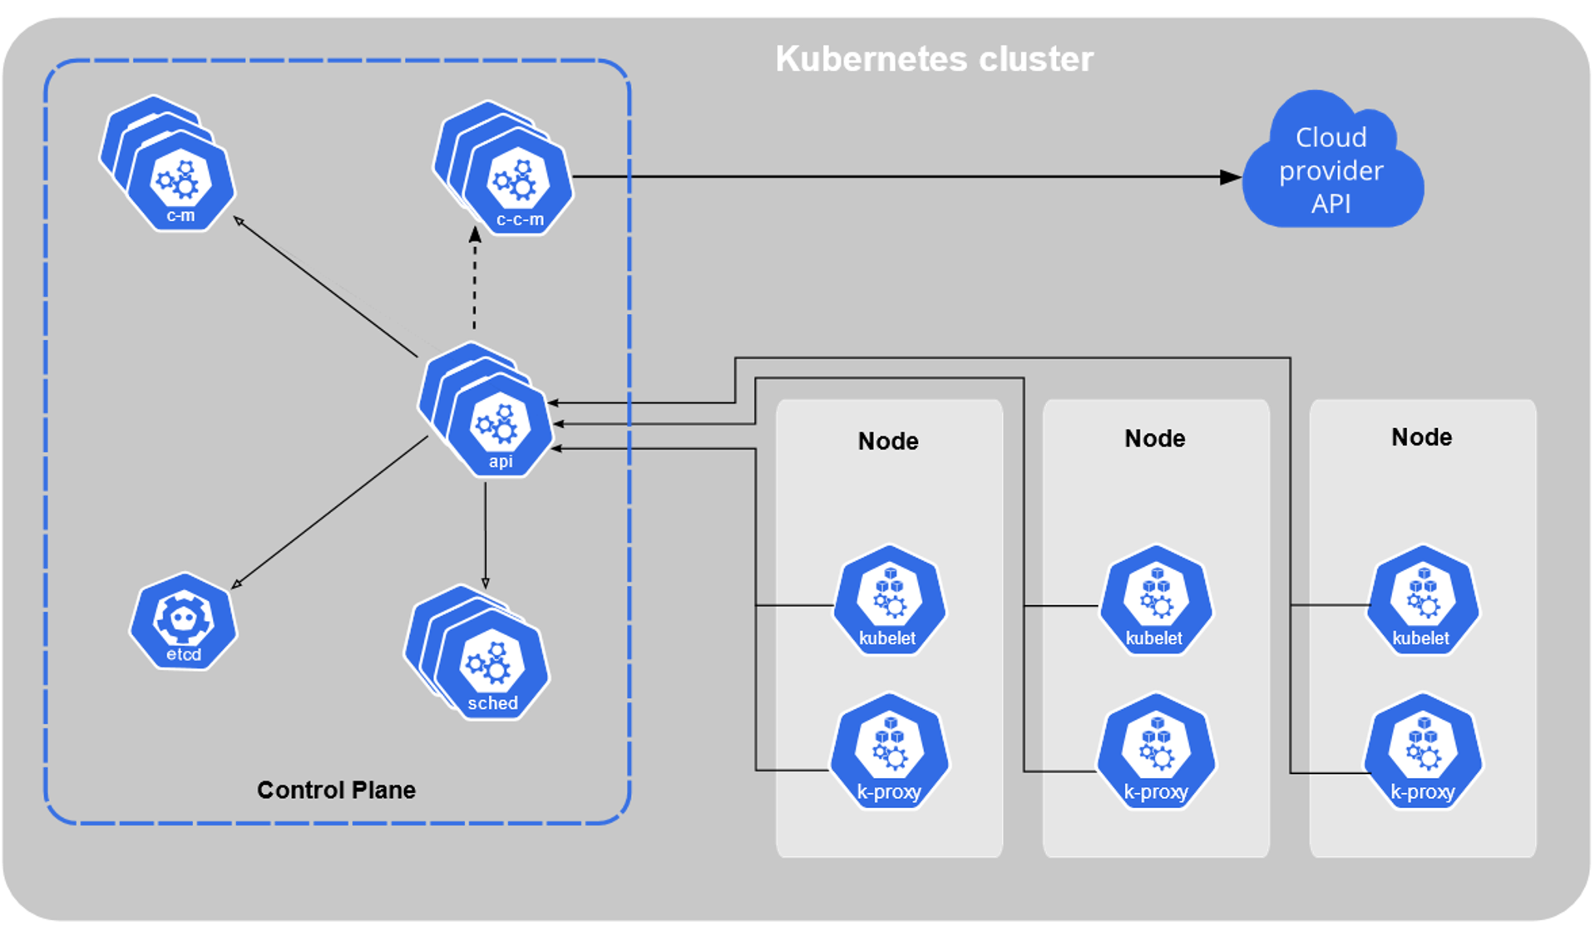
Azure Kubernetes Service
Kubernetes (K8s) is an open-source container orchestration system for automating software deployment, scaling, and management. (as opposed to running isolated containers).
Containers are a good way to bundle and run your applications.
In a production environment, you need to manage the containers that run the applications and ensure that there is no downtime. For ex., if a container goes down, another container needs to start
Kubernetes provides you with a framework to run distributed systems resiliently. It takes care of scaling and failover for your application, provides deployment patterns, and more
When you deploy Kubernetes, you get a cluster with master and worker nodes.
AKS simplifies deploying a managed Kubernetes cluster in Azure by offloading the operational overhead to Azure.
As a hosted Kubernetes service, Azure handles critical tasks, like health monitoring and maintenance.
Since Kubernetes masters are managed by Azure, you only manage and maintain the agent nodes.
Kubernetes Cluster

Slide 44
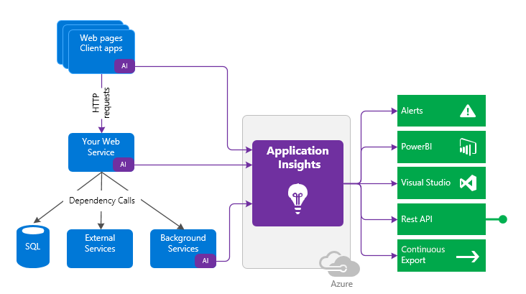
Application Insights is a feature of Azure Monitor that provides extensible application performance management and monitoring for live web apps.
Automatically detect performance anomalies.
Help diagnose issues by using powerful analytics tools.
See what users do with apps.
Help continuously improve app performance and usability.
In MLOps, Azure Application Insights is used to detect performance degradation.
Azure Application Insights

Slide 45
Avanade Resources for MLOps
CoE (Cluster of Excellence) offers MLOps trainings
A self-study version of the trainig is available at On Demand (sharepoint.com)

